Slide 1
GDP Growth Prediction
By Gopalakrishnan Kumar, MTech IIT-Bombay,
Freelance Data Science Consultant
LinkedIn: Profile Link : https://www.linkedin.com/in/gopalakrishnankumar-a73301110/
Github:https://www.github.com/Gopalakrishnan-Kumar/
Kaggle URL- https://www.kaggle.com/gopalkk2

Slide 2
Google Colab URL
https://colab.research.google.com/drive/1gW6b0byc9Bb7J-fxNkGNPOOkBCYtMy2g?usp=sharing

Slide 3
Introduction
Gross Domestic Product (GDP) growth is one of the most critical indicators of a country’s economic health. Policymakers, investors, and businesses rely on GDP forecasts to guide decision-making regarding monetary policy, investment strategies, and resource allocation. In this project, we use quarterly synthetic GDP growth data (2010–2024) and apply time series forecasting (ARIMA model) to predict GDP growth for the next two years (2025–2026).

Slide 4
Dataset Description
Period: Q1 2010 – Q4 2024
Frequency: Quarterly (4 observations per year)
Variable: GDP Growth Rate (%)
Additional Data: Synthetic Country B introduced for international comparison
The data is synthetic, generated using a normal distribution with mean growth ~2.5% and standard deviation ~0.8%. Country B’s growth rates were also generated with mean ~2.0% and standard deviation ~1.0% for comparison purposes.

Slide 5
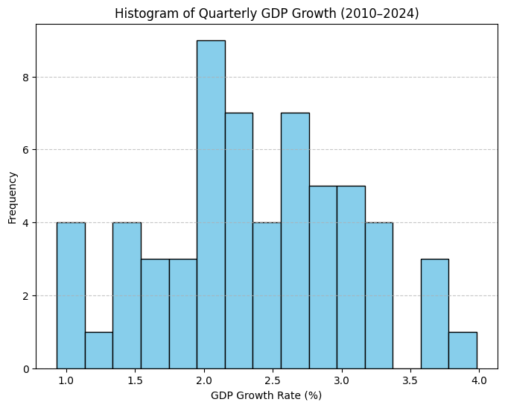
Data Visualization

Slide 6
Exploratory Data Analysis (EDA)
📊 3.1 Histogram of Quarterly GDP Growth
The histogram showed that most quarterly GDP growth rates fell between 1.5% and 3.5%, with a peak around 2.5%. This indicates that the dataset follows a normal distribution, mimicking real-world GDP patterns where economies generally grow steadily but experience occasional fluctuations.

Slide 7
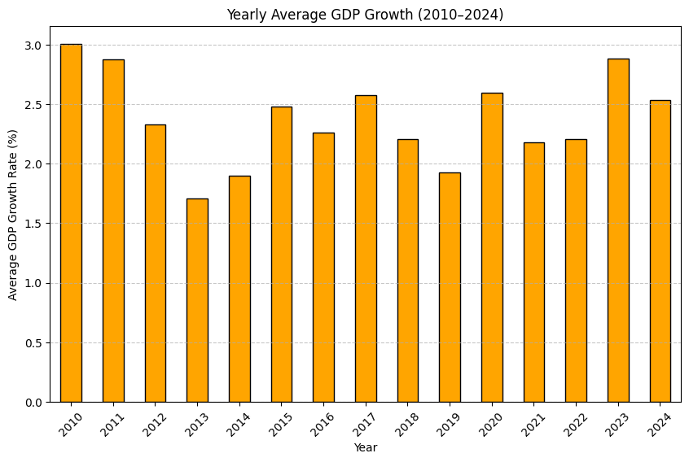
Data Visualization

Slide 8
Exploratory Data Analysis (EDA)
📊 3.2 Bar Chart – Yearly Average GDP Growth
The yearly average GDP growth plot revealed fluctuations over the years:
Growth remained stable in the early 2010s.
Some years showed slightly above-average performance (>3%), suggesting economic expansion.
Other years dipped closer to 1–2%, reflecting slowdown periods.
This trend aligns with real-world economies, where business cycles of expansion and contraction affect GDP growth.

Slide 9
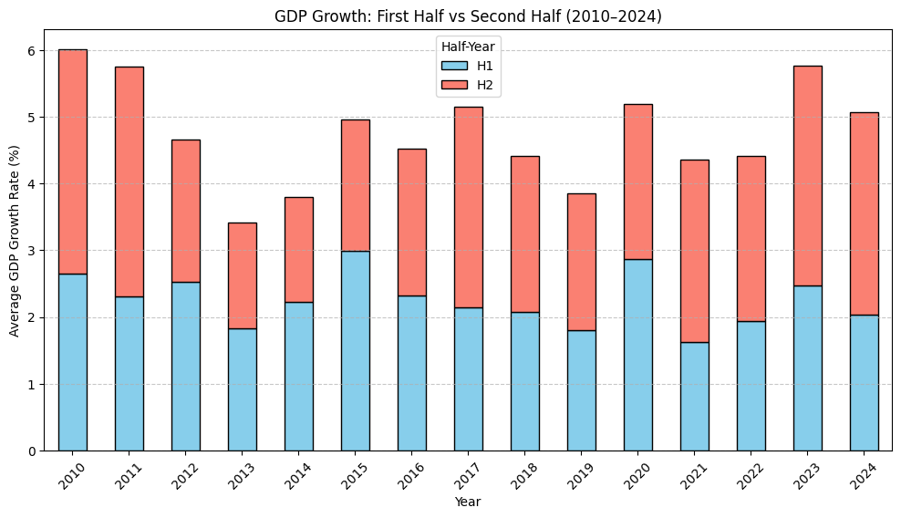
Data Visualization

Slide 10
Exploratory Data Analysis (EDA)
📊 3.3 Stacked Bar Chart – Half-Yearly Comparison
When comparing first half (H1: Q1–Q2) vs second half (H2: Q3–Q4):
In most years, growth was higher in the second half (H2), which could be linked to seasonal effects such as holiday-driven consumer spending and fiscal policy impacts.
In some years, H1 slightly outperformed H2, indicating shocks like global slowdowns or domestic policy changes.
This type of analysis helps governments plan fiscal interventions at specific times of the year.

Slide 11
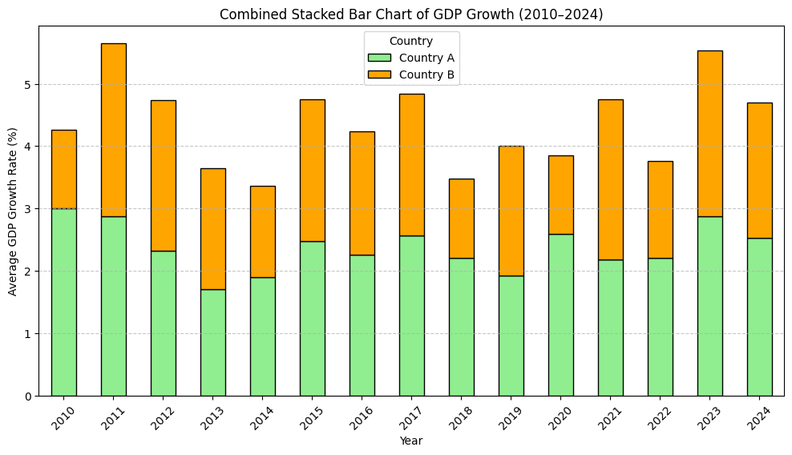
Data Visualization

Slide 12
Exploratory Data Analysis (EDA)
📊 3.4 Combined Stacked Bar Chart – Country A vs Country B
Country A (avg ~2.5%) generally showed stronger performance than Country B (avg ~2.0%).
Some years displayed significant divergence, where one country grew steadily while the other slowed down.
Comparing multiple countries provides insights into relative competitiveness and global economic interdependence.

Slide 13
Time Series Forecasting (ARIMA Model)
We applied an ARIMA(1,1,1) model to the quarterly GDP growth series.
Results:
The forecast for 2025–2026 suggests growth rates will stay within the range of 2.0% to 3.0%, indicating steady economic performance.
Confidence intervals widened slightly into the future, reflecting higher uncertainty.
No significant risk of negative GDP growth (recession) was observed in the forecasted horizon.

Slide 14
Insights & Conclusion
Stable Growth Trend – GDP growth remained within a healthy range (~2–3%) throughout the historical period.
Seasonality Effects – Growth in the second half of the year was generally stronger, useful for planning government spending cycles.
Cross-Country Comparison – Country A consistently outperformed Country B, highlighting stronger economic fundamentals.
Forecast – The ARIMA model projects steady growth in 2025–2026, with no major downturns expected.

Slide 15
Insights & Conclusion
📌 Applications:
Policy Makers: Plan monetary and fiscal policies.
Businesses: Adjust investment and expansion strategies.
Investors: Anticipate long-term returns and market stability.

